Slide 1
Works
1
Finish tissue category map for each WSI
2
Graph neural network
Others
1
Electric Circuits TA works

Slide 2
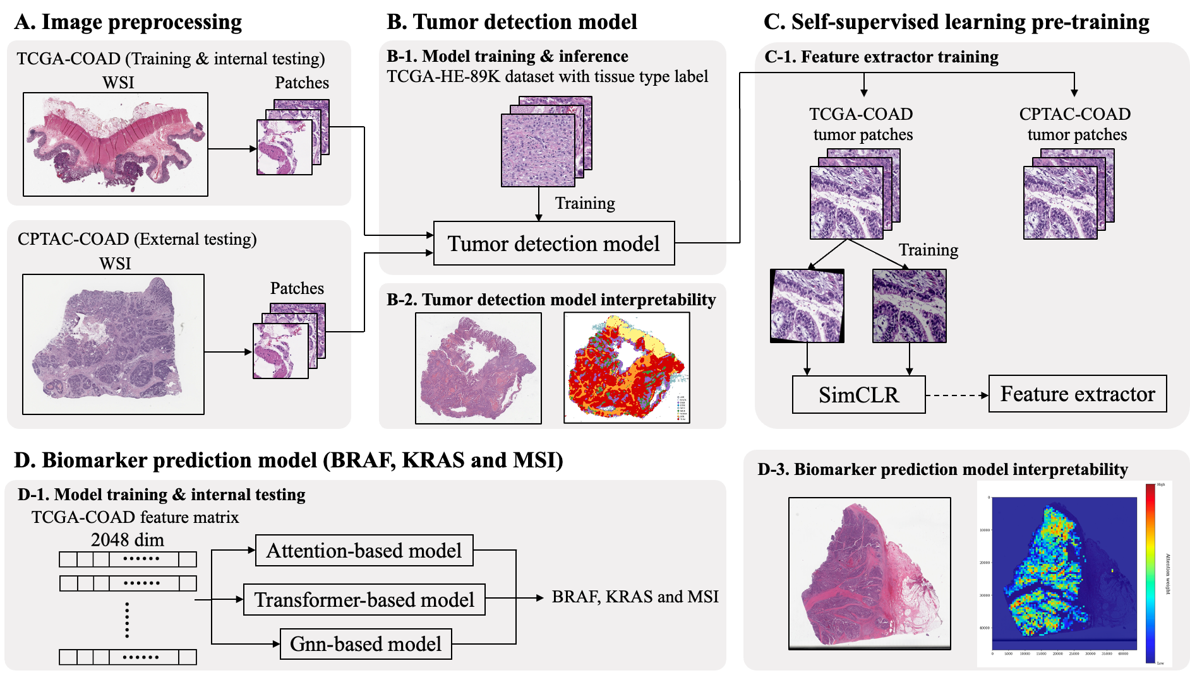

Slide 3
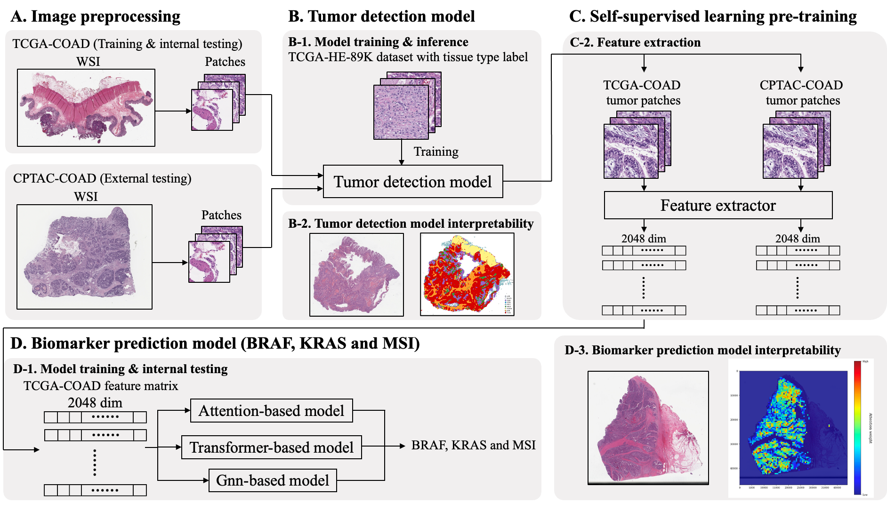

Slide 4
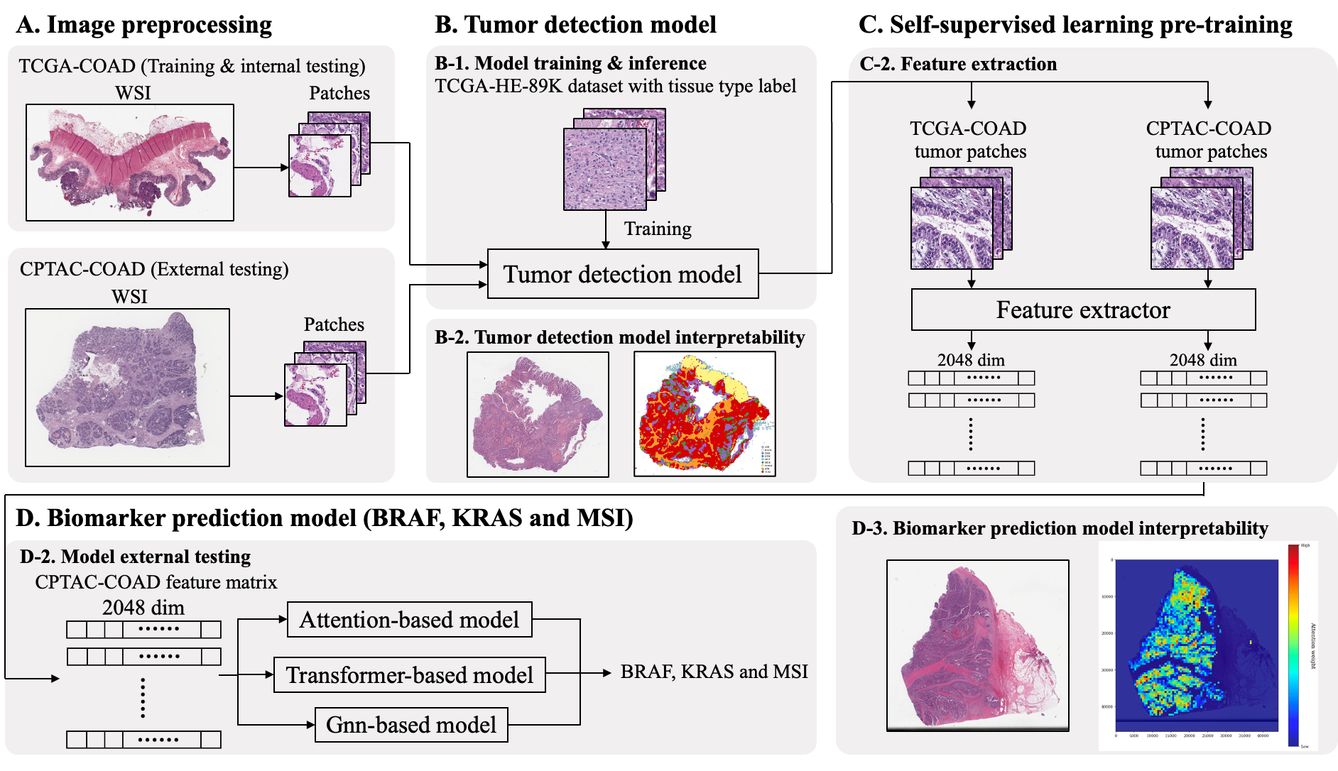

Slide 5
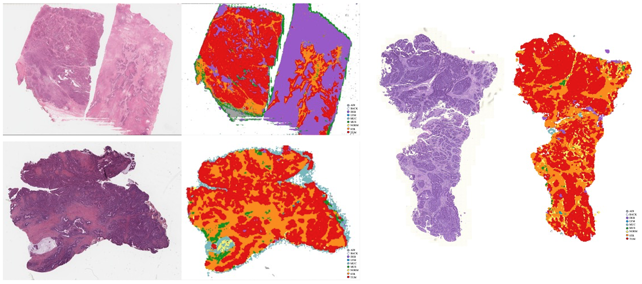
Tissue category map

Slide 6
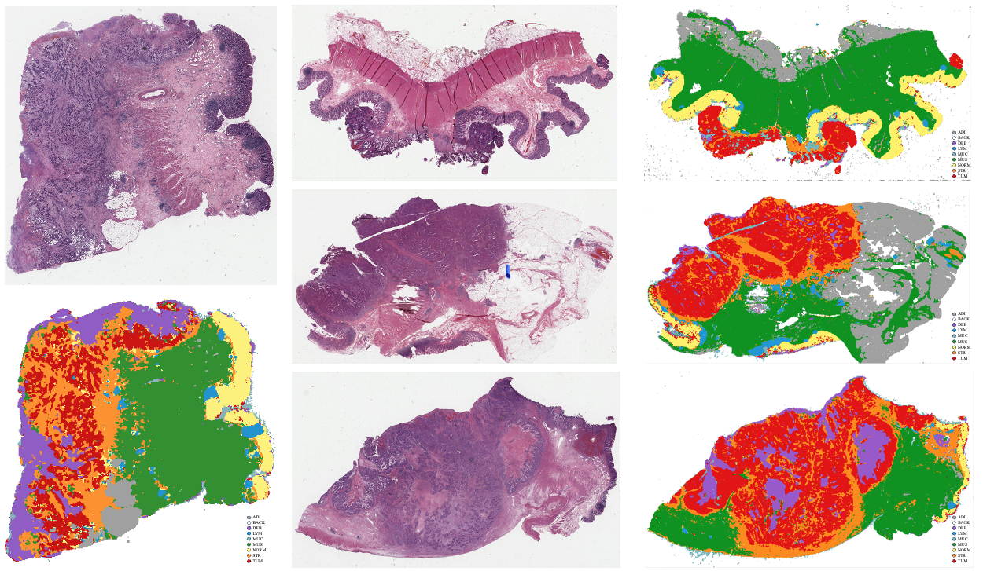

Slide 7
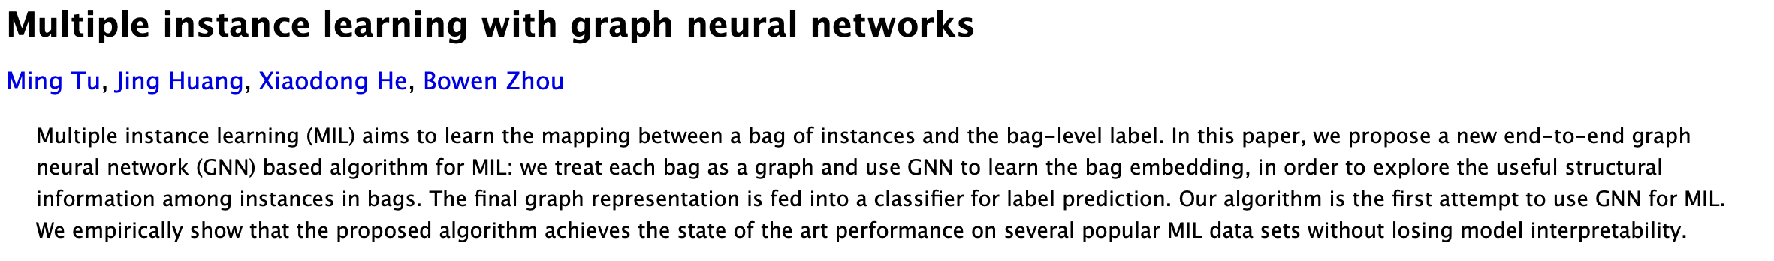
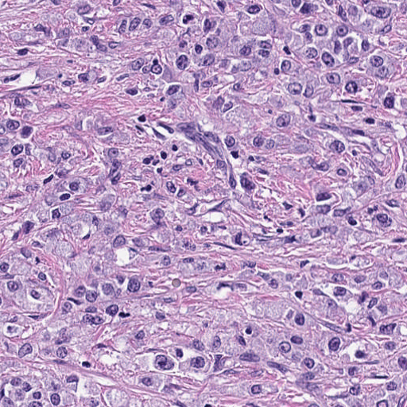
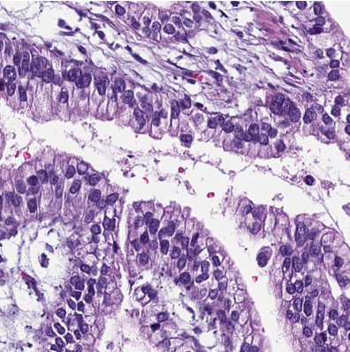
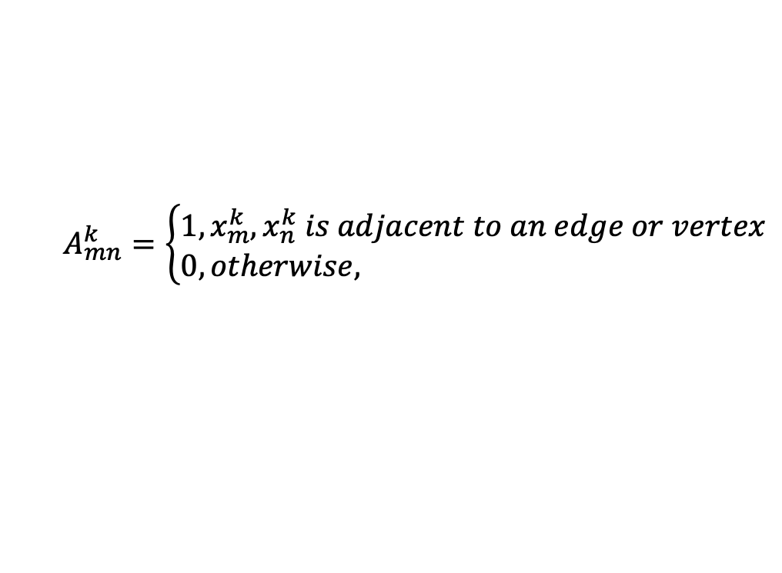
Graph neural network
Clarify doubt of the previous paper:
- what is the basis for establishing an edge between the two vertices?
$$A_{mn}^{k}=\left\{\begin{aligned}&1, x_{m}^{k}, x_{n}^{k} is adjacent to an edge or vertex \\ &0, otherwise,\end{aligned}\right.$$
(x_{j} , y_{j})
1
2
(x_{i} , y_{i})

Slide 8
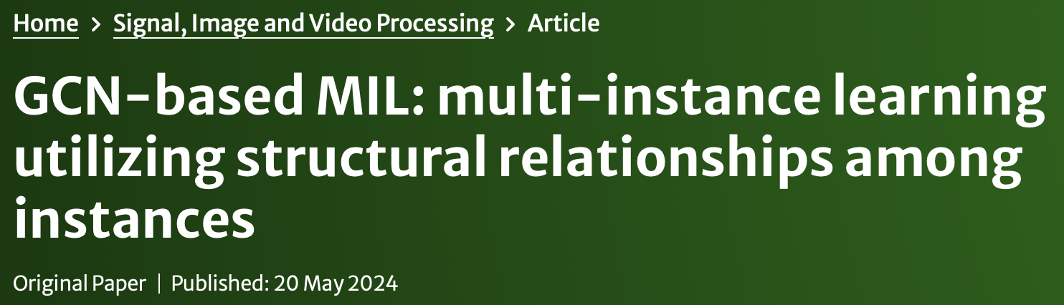
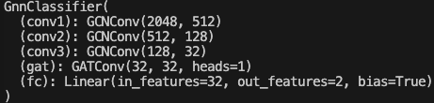
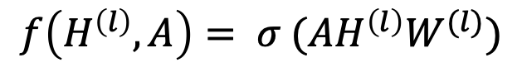
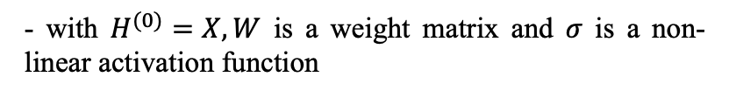
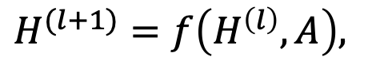
GnnMIL
Regard these question as multiple instance learning problem
GCNConv: graph convolutional network layer
$$H^{(l+1)}=f\left(H^{\left(l\right)}, A\right),$$
$f\left(H^{\left(l\right)}, A\right)= σ (AH^{\left(l\right)}W^{(l)})$
GCNConv: graph convolutional network layer
- X: feature matrix (N × D)
GATConv: graph attention network layer
- A: adjacency matrix (N × N)
mean pooling
- with $H^{(0)}=X, W$ is a weight matrix and 𝜎 is a non-linear activation function
Linear: fully-connected layer

Slide 9
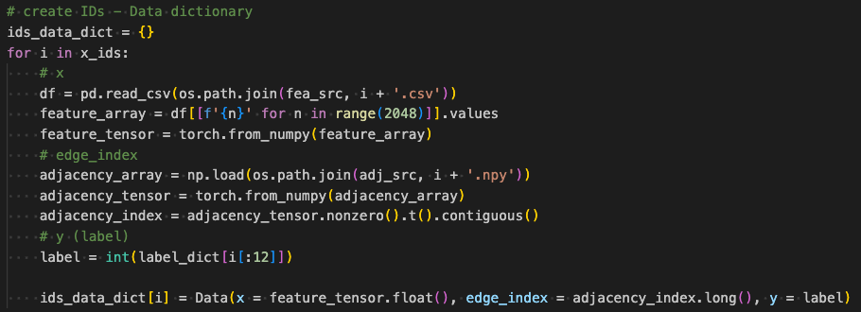

PyTorch Geometric
PyTorch Geometric (PyG) is a library built on top of PyTorch, designed to handle graph-structured data and implement graph neural networks (GNNs).
Most of the functions are similar to PyTorch such as torch_geometric.nn, torch_geometric.data and torch_geometric.loader. But Dataset establishment in PyG is more efficient than in PyTorch.
from torch_geometric.data import Data

Slide 10
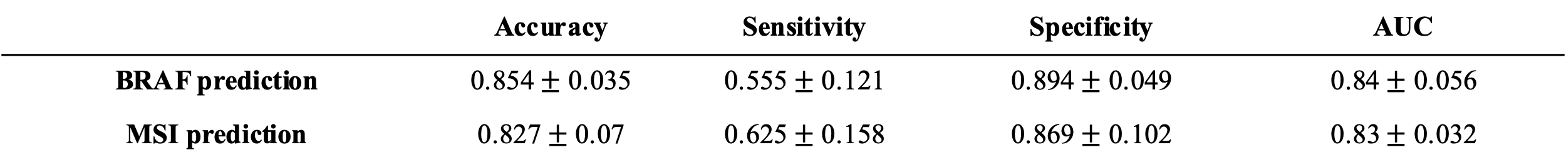
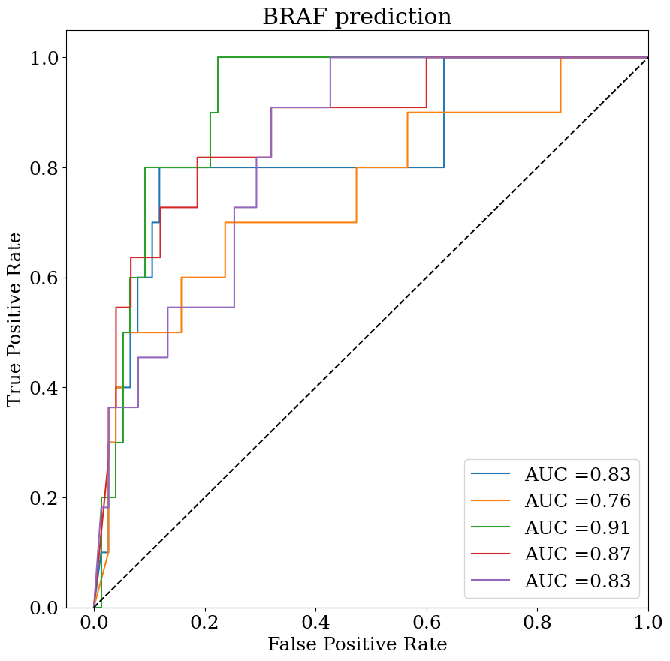
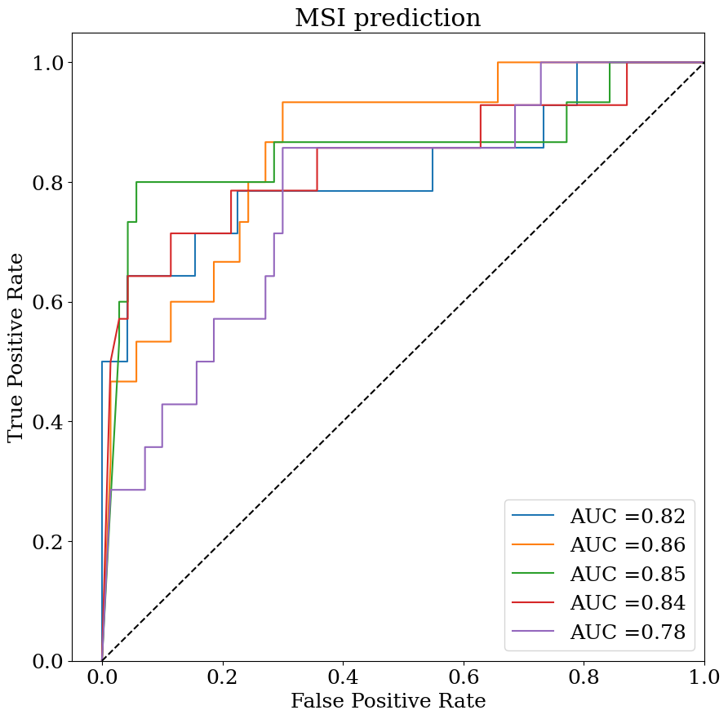
Preliminary internal testing results

Slide 11
Future works
1
Adjust GNN architecture of biomarker prediction

